Slide 1

Khatra Adibasi Mahavidyalaya
Department of Mathematics
Theory of Equations
Session : 2020-2021
Programme : Mathematics (Hons) Semester : 1st
Paper: Algebra (C2)
Date of Delivery : 10 th September 2020
Prepared by:
Dr. Rima Barik

Slide 2
Fundamental theorem of Algebra
Every equation has a solution, real or complex.
Once a problem is encountered, one only has to formulate an equation, using the conditions given in the problem.
The solution is assured.
But the implementation of the solution may or may not be possible, as the solution may not be real.

Slide 3
Some Basic Theorems :
If ‘a’ is a root of an equation f(x) = 0, then (x-a) is a factor of f(x).
If f(x) = 0 be an equation and ‘a’, ‘b’ be two real numbers, such that
f(a) f(b) < 0 , then f(x) = 0 has at least one root between a and b.
Every algebraic equation of degree ‘n’ has exactly n roots.
In an algebraic equation with rational coefficients, irrational roots occur in conjugate pairs.
In an algebraic equation with real coefficients, complex roots occur in conjugate pairs.

Slide 4

Relation between roots and coefficients of a quadratic equation:
If ${px}^{2}+qx+r=0$ is an equation whose roots are $α$and $β$ then :
$α+β =−\frac{q}{p}$
$αβ=\frac{r}{p}$

Slide 5

Relation between roots and coefficients of a cubic equation:
If ${px}^{3}+qx^{2}+rx+s=0$ is an equation whose roots are $α, β$ and $γ$ then :
$α+β+γ =−\frac{q}{p}$
$αβ+ βγ+ γα=\frac{r}{p}$
$αβγ=−\frac{s}{p}$

Slide 6
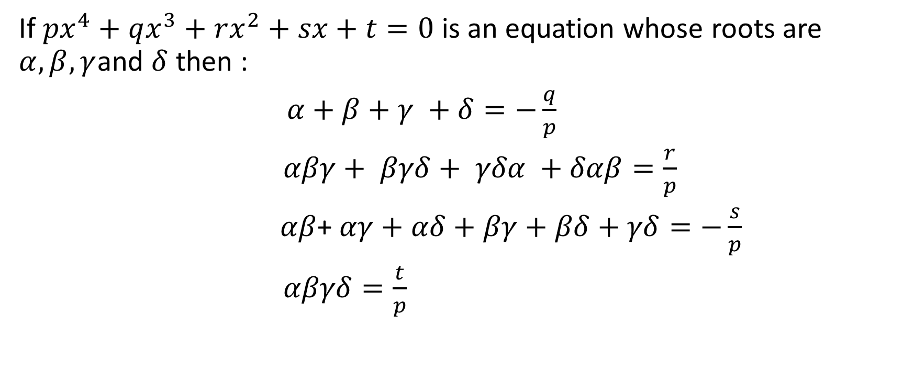
Relation between roots and coefficients of a biquadratic equation:
If ${px}^{4}+qx^{3}+rx^{2}+sx+t=0$ is an equation whose roots are $α, β,γ$and $δ$ then :
$α+β+γ +δ=−\frac{q}{p}$
$αβγ+ βγδ+ γδα +δαβ=\frac{r}{p}$
$αβ$+ $αγ+αδ+βγ+βδ+γδ=−\frac{s}{p}$
$αβγδ=\frac{t}{p}$

Slide 7
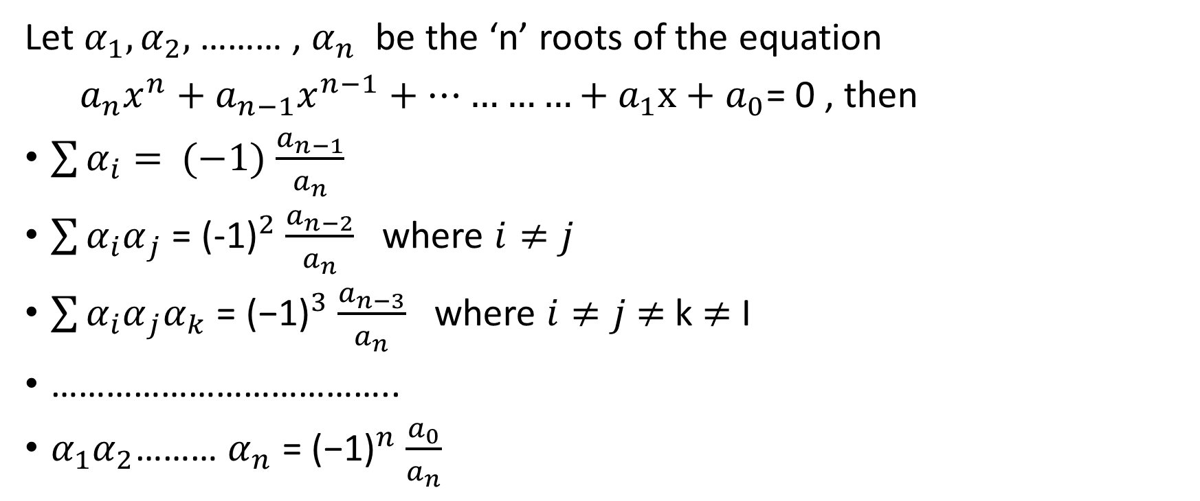
General Form of the Relation:
Let $α_{1}, α_{2},$……… , $α_{n}$ be the ‘n’ roots of the equation
${a_{n}x}^{n}+{a_{n−1}x}^{n−1}+…………+a_{1}x+a_{0}$= 0 , then
$\sum{α_{i}= }$ $(−1)$ $\frac{a_{n−1}}{a_{n}}$
$\sum{{α_{i}α}_{j}}$ = ${\text{(-1)}}^{2}$ $\frac{a_{n−2}}{a_{n}}$ where $i≠j$
$\sum{{{α_{i}α}_{j}α}_{k}}$ = ${\text{(−1)}}^{3}$ $\frac{a_{n−3}}{a_{n}}$ where $i≠j$ $≠$ k $≠$ I
………………………………..
$α_{1}α_{2}$……… $α_{n}$ = ${\text{(−1)}}^{n}$ $\frac{a_{0}}{a_{n}}$

